Slide 1


The Influence of Industry and Location on Data Analyst Salaries in Canada
PRINCIPLES OF ANALYTICS (DAMO 500-5)
Emmanuel Olajubu
2. Bushra Bushra
3. Vipul Khairnar
4. Parwinder Parwin
4th-Dec 2024
A Data-Driven Exploration

Slide 2
This project delves into the salary discrepancies to gain a deeper understanding of how industry and geographical location impact the remuneration of data analysts in Canada.
The primary objectives of this Project is to examine salary trends across industries ,analyze regional disparities and understand the combined influence of industry and position on salaries.
The scope is focused on Data Analyst roles in Canada using a dataset from Kaggle.
INTRODUCTION

Slide 3
H1: Industry Type Influences Salaries.
Null Hypothesis (H₀): No significant salary differences across industries.
Alternative Hypothesis (H₁): Significant salary differences exist.
H2: Geographic Location Impacts Salaries.
Null Hypothesis (H₀): No significant salary variation across regions.
Alternative Hypothesis (H₁): Significant salary variation exists.
H3: Interaction Between Industry Type and Position Affects Salaries.
Null Hypothesis (H₀): No interaction between industry type and position.
Alternative Hypothesis (H₁): Interaction significantly impacts salaries.
HYPOTHESES

Slide 4
DATA DESCRIPTION
The data set for this project is sourced from Kaggle, containing 1796 Listings in Canada, this dataset provides comprehensive information on data analyst job roles within Canada, including variables that are crucial for analyzing salary trends, industry impact, and geographic variation in job compensation.
Key Variables: Job Title, Average Salary, Industry, Region, Position
Preprocessing Steps:
Data cleaning, normalization, and feature engineering (e.g., remote work indicator, salary bands, positions).

Slide 5
METHODOLOGY OVERVIEW
H1 & H2 Methods:
Descriptive statistics, One-Way ANOVA, Chi-Square Test.
Visualizations: Box plots, bar charts.
H3 Methods:
Two-Way ANOVA, Kruskal-Wallis Test.
Visualizations: Salary distribution by industry and position.

Slide 6
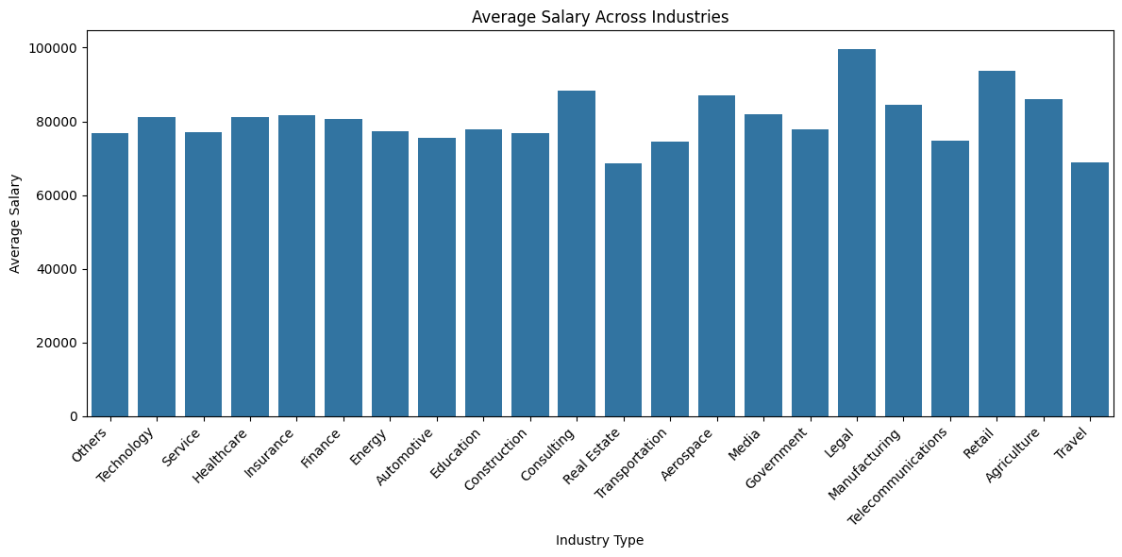
Results for Hypothesis One
Key Insights:
No significant differences in salaries across industries (p = 0.2755).
Technology had most job and legal had one of the highest average salary.
Visuals: Box plot and bar chart of industry salaries.
Conclusion: Fail to reject the null hypothesis.

Slide 7
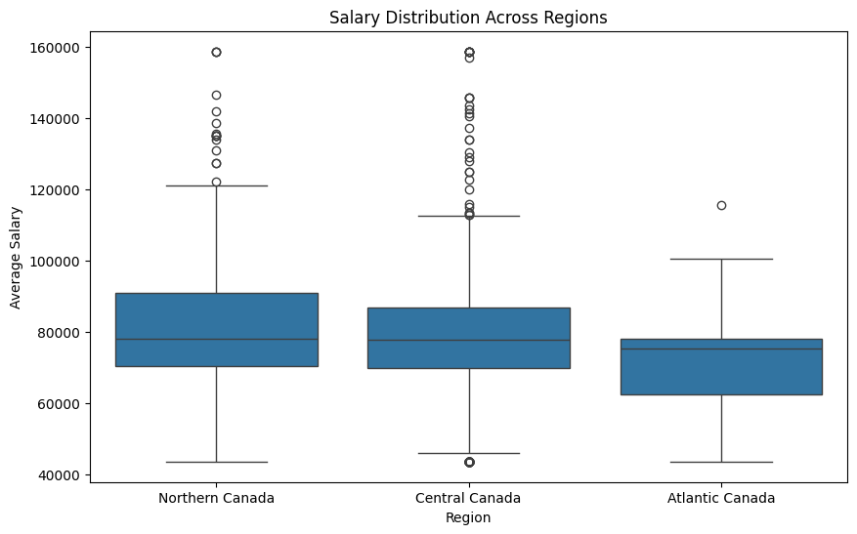
Results for Hypothesis Two
Key Insights:
Significant salary differences across regions (p < 0.05).
Northern Canada had the highest mean salary; Atlantic Canada the lowest.
Visuals: Box plot of regional salary distributions.
Conclusion: Reject the null hypothesis.

Slide 8
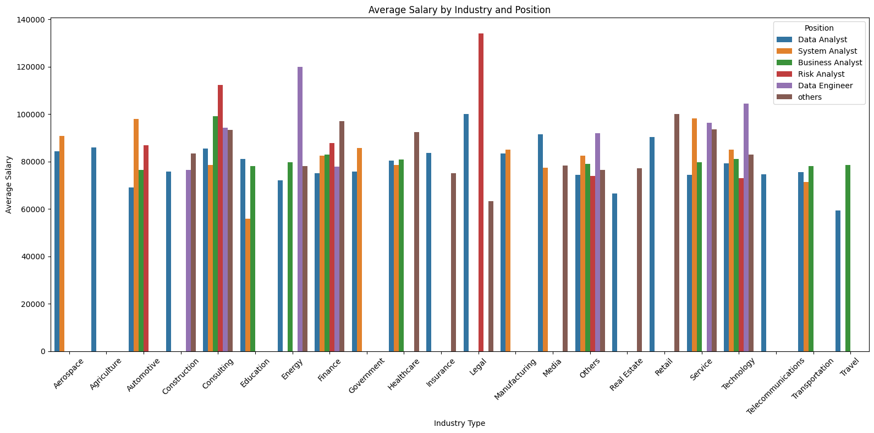
Results for Hypothesis Three
Key Insights:
Significant interaction effect between industry type and position (p < 0.001).
Technology and Finance sectors show substantial variations by position.
Visuals: Bar and box plots for salary by industry and position.
Conclusion: Reject the null hypothesis.

Slide 9
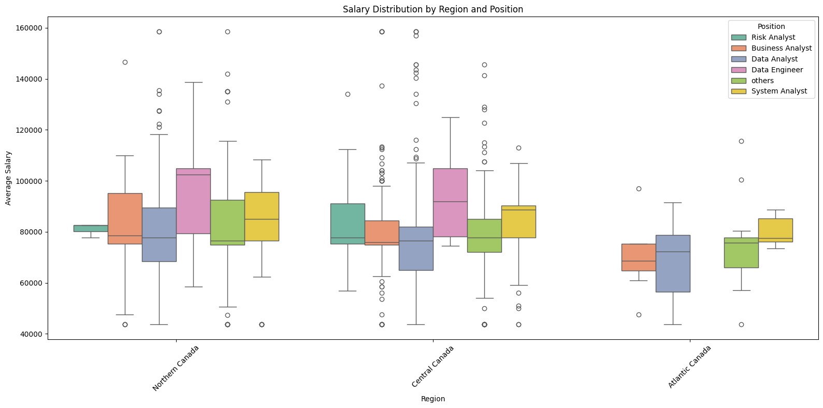
Results for Hypothesis Three

Slide 10
Tools and Technique
To conduct the analysis and validate the hypotheses, the following tools and techniques were employed:
1. Python Libraries:
pandas: For data manipulation and descriptive statistics.
matplotlib and seaborn: For creating visualizations (e.g., bar charts, box plots).
scipy.stats: For performing statistical tests like ANOVA and Chi-Square.
statsmodels: For Two-Way ANOVA and regression analysis.
2. Statistical Methods:
Descriptive Statistics: Summarizing data trends and variability.
One-Way ANOVA: Testing differences in mean salaries across industries and regions.
Two-Way ANOVA: Examining the interaction between industry type and position.
Kruskal-Wallis Test: Non-parametric alternative to ANOVA for non-normal data.
Chi-Square Test: Assessing associations between categorical variables.

Slide 11
Tools and Technique
To conduct the analysis and validate the hypotheses, the following techniques were used:
Visualization Techniques:
Bar Charts: For comparing average salaries.
Box Plots: To illustrate salary distributions and identify outliers.

Slide 12
DISCUSSION
Findings:
Industry and location influence salaries, with regional economic factors playing a pivotal role.
Legal , Technology , Healthcare and Finance sectors remain top industries and offering competitive salaries.
Interaction effects highlight the importance of role-specific compensation strategies.
Limitations:
Insufficient data for smaller industries (e.g., Agriculture, Telecommunications).
Regional representation uneven across provinces.

Slide 13
RECOMMENDATIONS
For Employers:
Use industry-specific and regional pay adjustments to attract talent.
For Job Seekers:
Target high-paying sectors (e.g., Technology, Finance) and regions (e.g., Northern Canada).
For Policymakers:
Advocate for equitable pay practices and regional incentives.
For Researchers:
Explore emerging sectors and longitudinal data for trends.

Slide 14
CONCLUSION
Summary:
Industry type, geographic location, and role interaction significantly influence salaries.
Recommendations aim to address disparities and promote equitable practices.
Future Work:
Investigate salary trends in emerging sectors.
Extend the analysis to international comparisons.

Slide 15
QUESTIONS AND DISCUSSIONS
What additional factors should we consider when analyzing salary trends?

Slide 16
"Data analysts are like detectives, except our magnifying glass is Excel, our suspects are numbers, and we always work overtime solving mysteries no one knew existed!" 😄
"We don't guess; we pivot-table until the truth comes out!"

